Slide 1
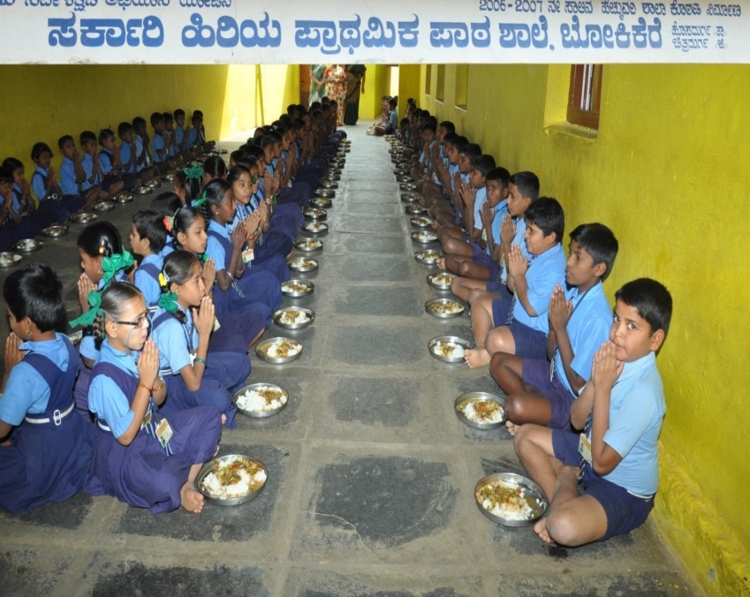
MID DAY MEAL SCHEME
KARNATAKA
Annual Work Plan & Budget 2018-19
Place: Shastri Bhavan Date: 15.06.2018
New Delhi

Slide 2
Performance 2017-18
Coverage of schools : Existing v/s Coverage
Schools | No of schools | Covered | Difference
Primary Schools (1 to 5) | 21434 | 21434 | 0
Upper Primary Schools with Primary Schools (1 to 8) | 24936 | 24934 | 2
Upper Primary schools (6 to 8) | 8205 | 8205 | 0
Madarasa | 37 | 37 | 0
NCLP | 27 | 27 | 0
Total | 54639 | 54637 | 2
Reasons for difference : Mid day Meal is served by Temples.(Dakshina Kannada)

Slide 3
Coverage - Children
(In Lakhs)
Regular days
Classes | PAB APPROVAL | ENROLMENT | AVERAGE BENEFICIARIES | % Against to Enrolment
Primary | 28.08 | 29.13 | 27.08 | 92.96%
Upper Primary | 16.70 | 17.95 | 16.12 | 90%
Total | 44.78 | 47.10 | 43.20 | 91.71%
Drought days
Classes | PAB APPROVAL | ENROLMENT | BENEFICIARIES | % Against to Enrolment
Primary | 15.65 | 15.65 | 7.13 | 46%
Upper Primary | 9.23 | 9.23 | 6.1 | 66.33%
Total | 24.89 | 24.89 | 13.23 | 53.15%
Enrolment based on SATS-2017-18

Slide 4
Food grains: Utilization- 2017-18
(In MTs)
Classes | Annual Allocation for the year 2017-18 | Opening Balance 1/4/2017 | Lifted Till 31-03-2018 |  | Utilization Till 31.03.2018 | Balance |  | % of Utilisation
1 | 2 | 3 | 4 |  | 5 | 6=3+4-5 |  | 7
RICE
Primary | 60545.06 | 871.88 | 58290.22 | 58685.05 |  | 477.06 |  | 99.2%
Upper Primary | 53996.40 | 659.19 | 51925.09 | 52217.06 |  | 367.21 |  | 99.3%
Total | 114541.46 | 1531.07 | 110215.31 | 110902.11 |  | 844.27 |  | 99.2%
WHEAT
Primary | 4406.39 | 195.72 | 1089.72 |  | 1285.436 |  | 0 | 100%
Upper Primary | 3983.71 | 211.30 | 1005.23 |  | 1216.52 |  | 0 | 100%
Total | 8390.10 | 407.02 | 2094.95 |  | 2501.956 |  | 0
Grand Total | 122931.56 | 1938.09 | 112310.26 |  | 113404.06 |  | 844.27

Slide 5
Financial Progress - 2017-18
Component | Budget Provision |  |  | OB | Releases |  |  |  | Expenditure |  |  | % of expenditure
 | Central Share | State Share | Total |  | Central Share |  | State Share | Total | Central Share | State Share | Total
2 | 3 | 4 | 5 |  | 9 |  | 10 | 11 | 12 | 13 | 14 | 15
Recurring Assistance
Cost of Food grains | 4064.93 | 0.00 | 4064.93 | 568.83 | 3437.96 | 0.00 |  | 3437.96 | 3438.35 | 0.00 | 3348.35 | 83.57
Cooking Cost | 33560.80 | 22335.83 | 55896.70 | 2463.97 | 32059.62 | 21373.08 |  | 53432.70 | 30914.06 | 20555.51 | 51469.57 | 92.08
Honorarium to cook-cun-heleper | 7798.40 | 5198.94 | 12997.30 | 256.18 | 7644.69 | 5096.47 |  | 12741.16 | 7470.32 | 4980.99 | 12451.31 | 95.80
Transportation Assitance | 1016.23 | 0.00 | 1016.23 | 154.49 | 847.20 | 0.00 |  | 847.20 | 842.32 | 0.00 | 842.32 | 84.09
MME | 835.94 | 0.00 | 835.94 | 35.53 | 799.10 | 0.00 |  | 799.10 | 834.63 | 0.00 | 834.63 | 100.00
Subtotal | 47276.34 | 27534.77 | 74811.11 | 3479.00 | 44788.57 | 26469.55 |  | 71258.12 | 43409.68 | 25536.50 | 68946.18 | 92.25
Non-Recurring Assistance
Kitchen Devices | 0 | 0 | 0 | 0 | 0 | 0 |  | 0 | 0 | 0 | 0 | 0
Kitchen-Cum-Stores | 0.6 | 0 | 0 | 0 | 0 | 0 |  | 0 | 0 | 0 | 0 | 0
Subtotal | 0.6 | 0 | 0.6 | 0 | 0 | 0 |  | 0 | 0 | 0 | 0 | 0
GRAND TOTAL | 47276.9 | 27534.7 | 74811.7 | 0 | 44788.6 | 26469.6 |  | 71258.1 | 43409.7 | 25574.6 | 68984.2 | 92.25

Slide 6
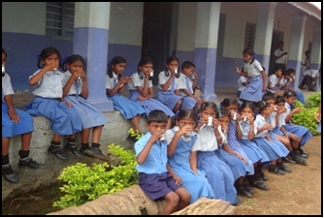
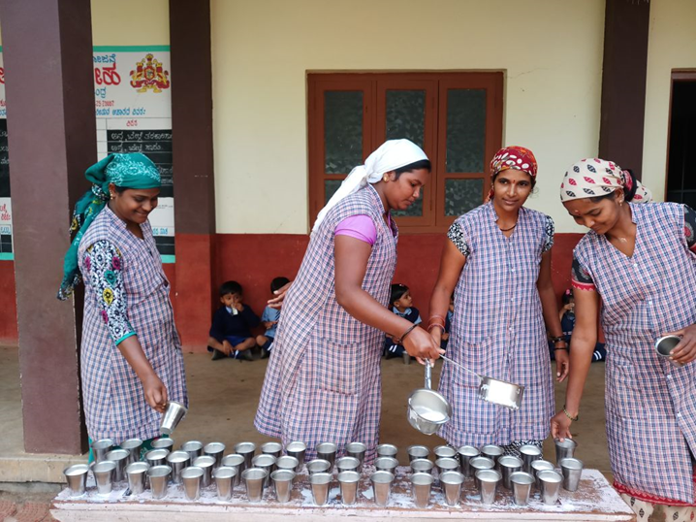
Best Practices
Ksheera Bhagya Yojana
GOK has introduced Ksheera Bhagya Yojana. 150ml of hot Milk provided to all children from Class1 to 10th in Govt and Aided Schools for 5 days in a week.
Karnataka Milk Federation (KMF) supplies milk powder.
18 grams of Whole Milk Powder is converted into 150ml Milk at the cost of Rs.5.18 per day per child.

Slide 7
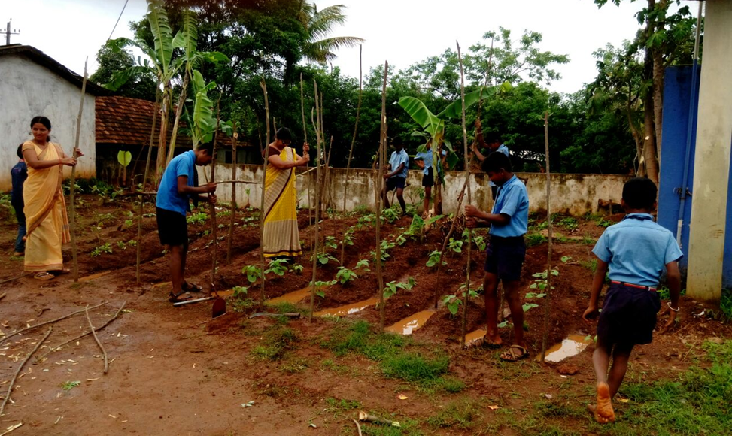
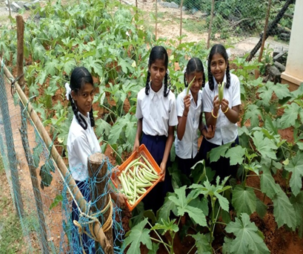
Best Practices …….Contd
Kitchen Garden
Kitchen Gardens are maintained in 8923 schools
The main objective of maintaining kitchen gardens is to grow required vegetables and green leaves for MDM in schools with the help of children.
Department of Horticulture is supplying required saplings to schools .

Slide 8
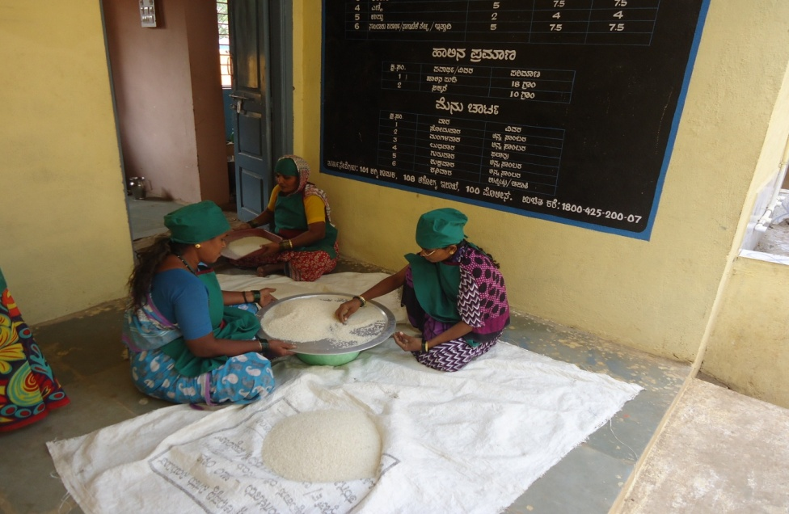
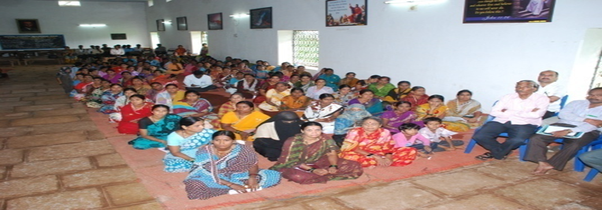
Best Practices …….Contd
Cook cum helpers 2017-18
Approved- 118199 Working-118130
Apron provided to CCHs
.
Training to CCHs

Slide 9
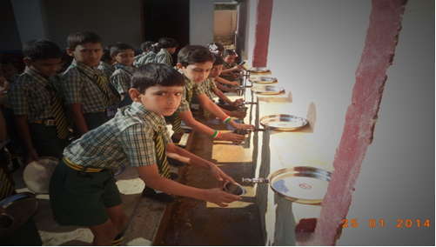
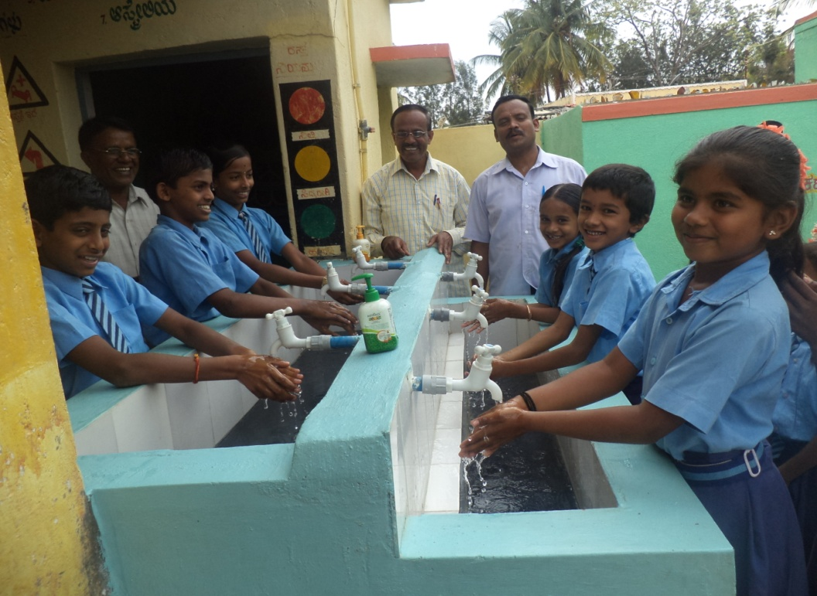
Hand washing units
in collaboration with NGO/CSR

Slide 10
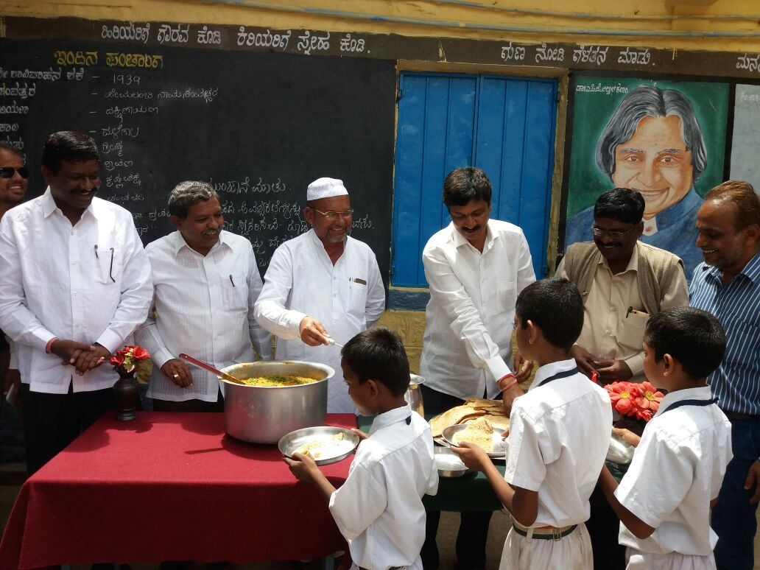
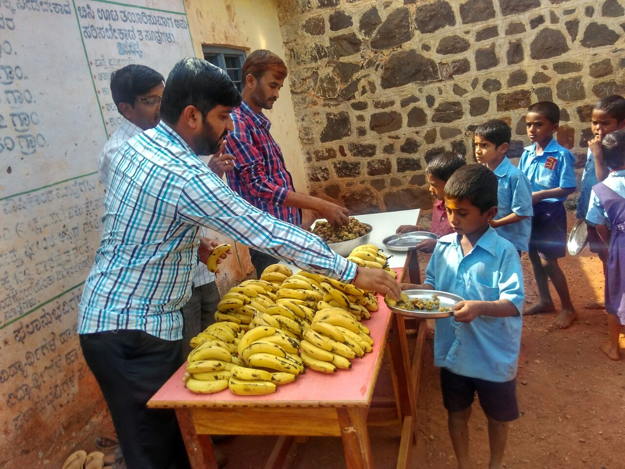
Best Practices …….Contd
SDMC and Mothers Committee are actively involved in MDM.

Slide 11
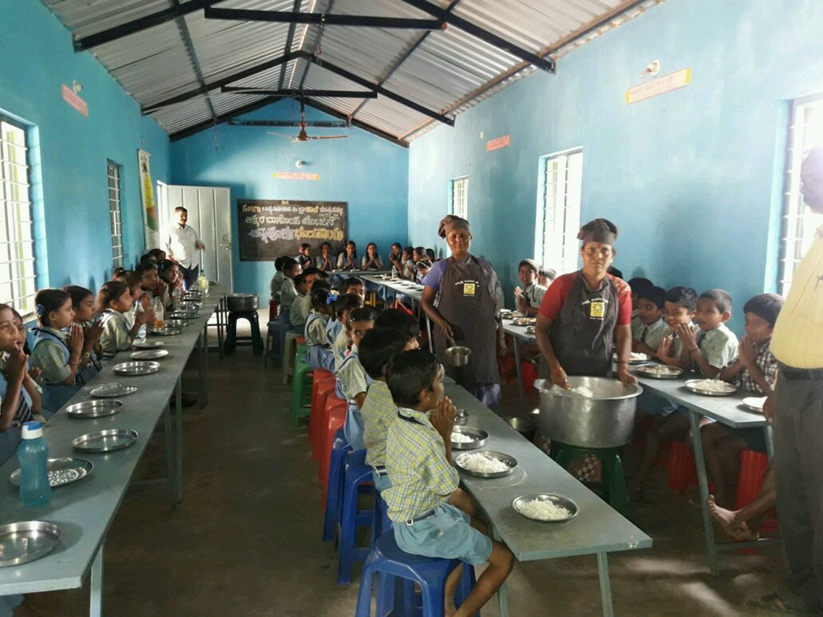
Best Practices …….Contd
Dining halls are constructed with the help of elected representatives/NGO/Corporates/Community.

Slide 12
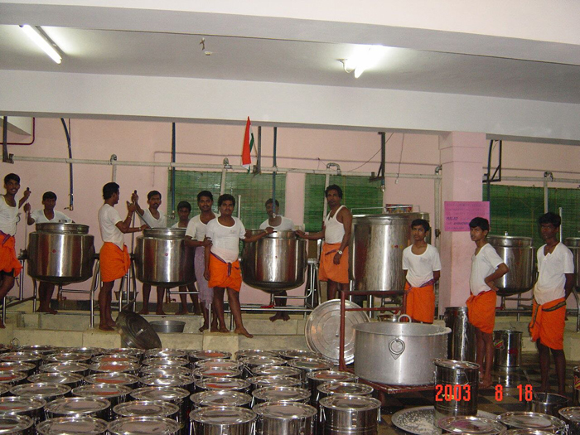
Best Practices …….Contd
Involvment of NGOs in Mid day Meal scheme.
Total 66 NGOs are involved in 14 Districts supplying food to 709058 Children of 5523 Schools.
The NGOs namely Akshaya Patra, Adamyachetana, Guru Shanteshwara , Samvruddi and JSS are covering more than 20000 Children.

Slide 13
MILLETS
Implemented in 10 schools of Bengaluru urban district on pilot basis by Akshaya Patra.
No. of Beneficiaries 1500.
List of millets and recipes prepared during trials:
Sr. No. | Millet | Recipes
 | Pearl millet | Bisi-bele-bath, khichdi, upma
2. | Little millet | Bisi-bele-bath, khichdi, upma, pulav
3. | Kodo millet | Pulav, khichdi
4. | Finger millet | Sweet upma, idly
5. | Proso millet | Bisi-bele-bath

Slide 14
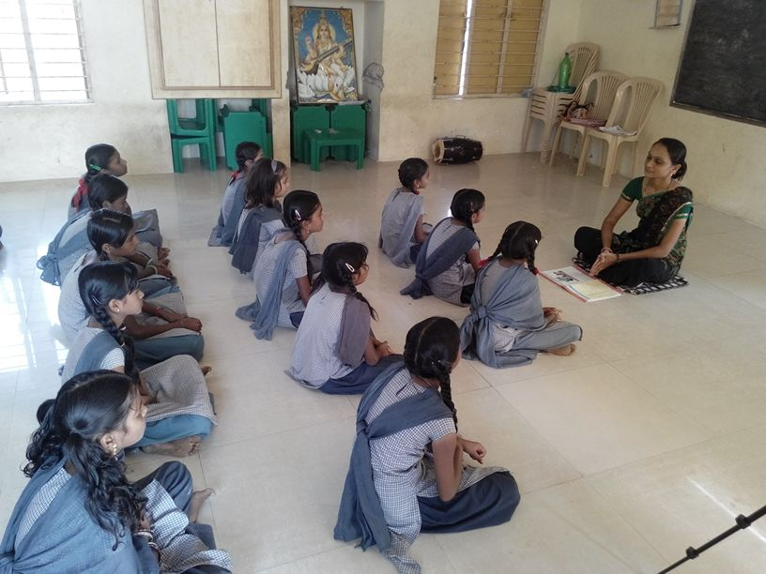
YOGA AND MEDITATION
A new experiment for 200 students in 6 Govt. Schools who have failed in SSLC examination
Yoga, Meditation and Mind games are introduced experimentally for better results.
Students will undergo 3 or 4 sessions of Pragna Yoga every day.

Slide 15
Fortification of Rice
Fortified rice was used by Akshaya Patra for MDM in 5 Districts ( Bengaluru, Bellary, Dakshina Kannada, Mysuru and Dharawad)as pilot during 2016-17 and 2017-18.
GoK has taken initiation to supply FRK to the decentralised kitchen centers of Kolar, Chamaraja Nagar, Koppal and Belagavi districts for 3 years from 2018-19 to 2020-21.
Rs 25 Crore is alloted for the purpose and the work is under progress.

Slide 16
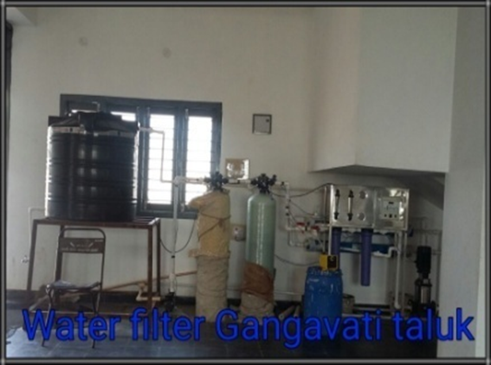
Water Filtration
All Schools have safe Drinking Water facility.
No of School Filtration facility – 11629(RO-5570, UF – 1189, E Boiling – 856, Carbon filter – 1313, Candle Filter – 2953)
This facility have been provided to the Schools with the help of Community, Donors, CSR fund

Slide 17
Proposed Schools, for the year 2018-19
Class | Schools
Primary Schools (1 to 5) | 21434
Upper Primary Schools with Primary Schools (1 to 8) | 24936
Upper Primary schools (6 to 8) | 8205
Madarasa | 37
NCLP | 27
MOULANA AZAD | 200
Total | 54839

Slide 18
Proposed Children and working days for the year 2018-19
Classes | (Govt+LB) Schools | Aided Schools | Madarasa/ Maqtab | Total | Working Days
Primary | 2329102 | 377953 | 1666 | 2708721 | 240
Upper Primary | 1258181 | 366445 | 826 | 1625452 | 240
Total | 3587283 | 744398 | 2492 | 4334173 | 240
 | NCLP Schools
 | No. of Districts | No. of Schools | Children | Working Days
 | 6 | 27 | 1112 | 312
Note : Target for 2018-19 (1 to 8^{th)} 43.35 Lakhs

Slide 19
Requirement of Food Grains: 2018-19
(In MTs)
Class | Rice | Wheat | Total
Primary | 53903.55 | 11105.76 | 65009.30
Upper Primary | 48519.74 | 9996.53 | 58516.27
NCLP | 42.37 | 9.67 | 52.04
Total | 102465.62 | 21111.93 | 123577.62

Slide 20
Budget Proposal: 2018-19
(Rs. In Lakhs)
Sl. No | Component | Primary |  |  | Upper Primary |  |  | Grand Total
 |  | Central Share | State Share | Sub Total | Central Share | State Share | Sub Total | Central Share | State Share | Sub Total
Recurring Assistance
1 | Cost of Foodgrain | 1839.22 | 0.0 | 1839.22 | 1656.99 | 0.00 | 1656.99 | 3496.21 | 0.00 | 3496.21
2 | Cooking cost | 17357.48 | 11571.7 | 28929.14 | 15555.74 | 10370.50 | 25926.24 | 32913.23 | 21942.15 | 54855.38
3 | Honorarium to CCH | 2598.24 | 1732.2 | 4330.40 | 4489.56 | 2993.04 | 7482.60 | 7087.80 | 4725.20 | 11813.00
4 | Transportation Assistance | 487.57 | 0.0 | 487.57 | 439.26 | 0.00 | 439.26 | 926.83 | 0.00 | 926.83
5 | MME | 401.09 | 0.0 | 401.09 | 398.55 | 0.00 | 398.55 | 799.63 | 0.00 | 799.63
Sub Total |  | 22683.60 | 13303.82 | 35987.42 | 22540.10 | 13363.54 | 35903.64 | 45223.70 | 26667.35 | 71891.05
Non Recurring
7 | Kitchen sheds | 0 | 0 | 0 | 0 | 0 | 0 | 0 | 0 | 0
8 | Kitchen devices | 537.60 | 0 | 537.60 | 631.20 | 0 | 631.20 | 1168.80 | 0 | 1168.80
Kitchen Garden |  | 1403.70 | 0 | 1403.70 | 1647.80 | 0 | 1647.80 | 3051.50 | 0 | 3051.50
Grand Total |  | 24624.90 | 13303.82 | 37928.72 | 24819.10 | 13363.54 | 38182.64 | 49444.00 | 26667.35 | 76111.35

Slide 21
Success stories …….Contd
99.99% of schools are using LPG.
Fire Extinguishers in all schools.
Additional Honorarium of Rs. 1700/- per month is being given to CCH by GOK. At present head cook is getting Rs. 2700/- and Asst cook is getting Rs. 2600/- Per month.
Dinning halls constructed with stakeholders participation/donors .
Involvement of NGOs/Trusts in providing Breakfast, Nutritious Biscuits and development of Kitchen gardens at their own cost.

Slide 22
ISSUES
Transportation allowance need to be enhanced from Rs. 750 to Rs.1500 per MT.
Cook cum Helpers honorarium need to be increased from
Rs.1000 to Rs. 2000
Minimum 2 cook cum helpers for Lower Primary school should be given.
Minimum Cooking cost should be fixed to the Schools
which have less than 50 Students.
Cooking cost should be enhanced according to Price Index.
Cost for Kitchen devices at present is Rs.5000/- . It should
be increased to Rs.15000/- per unit.
Increase of MME from 1.8% to 3 %.

Slide 23
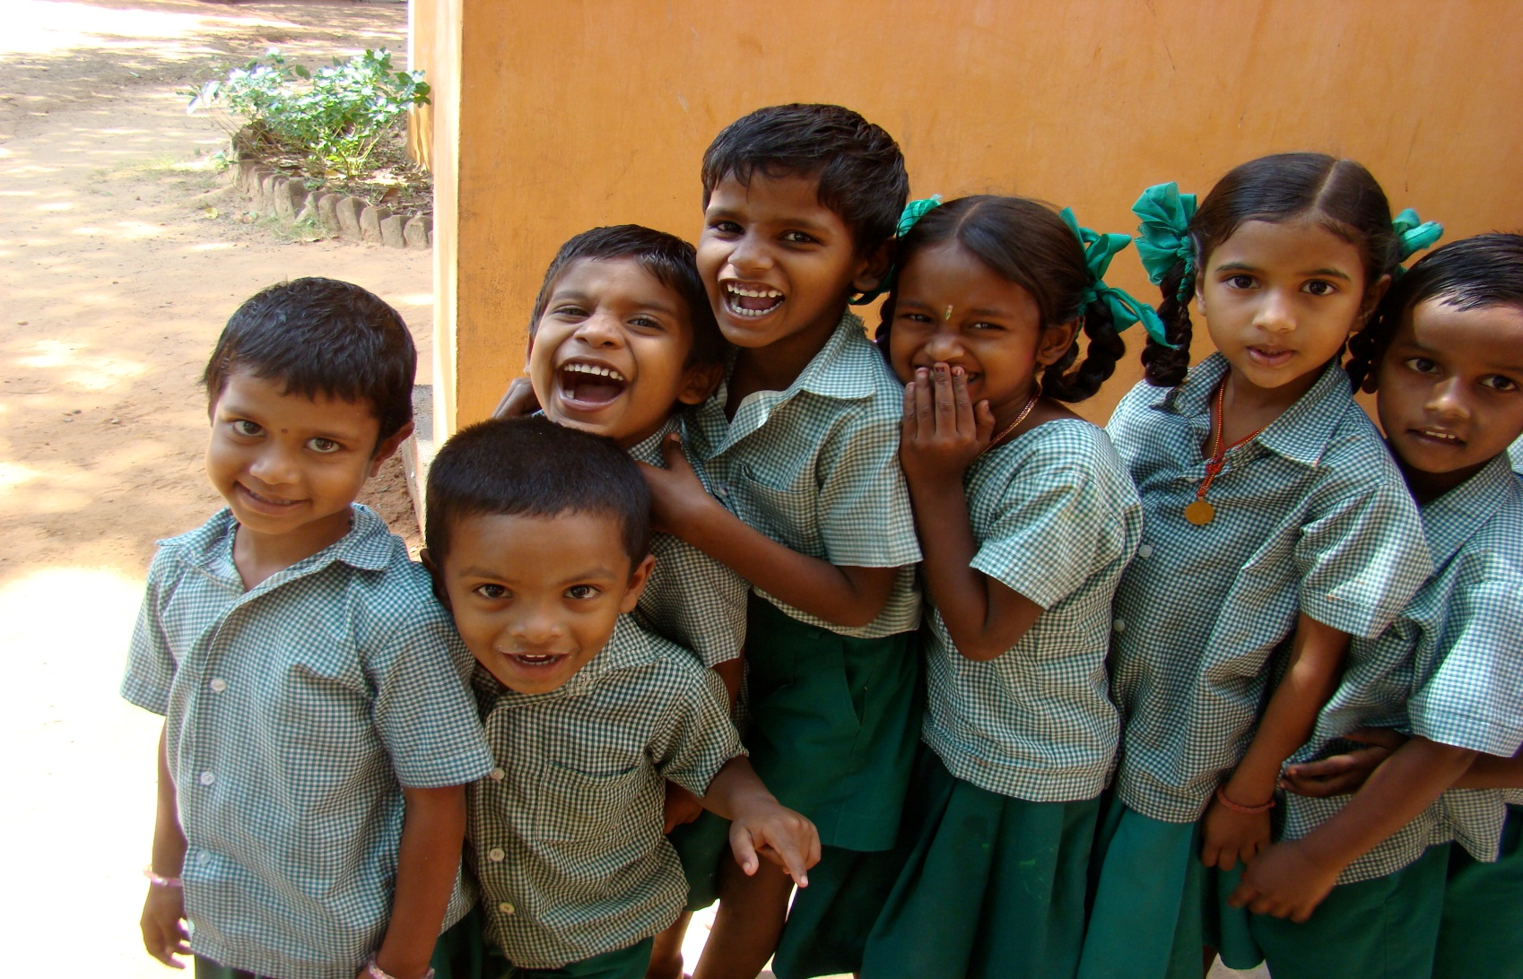
Thank You

